Slide 1
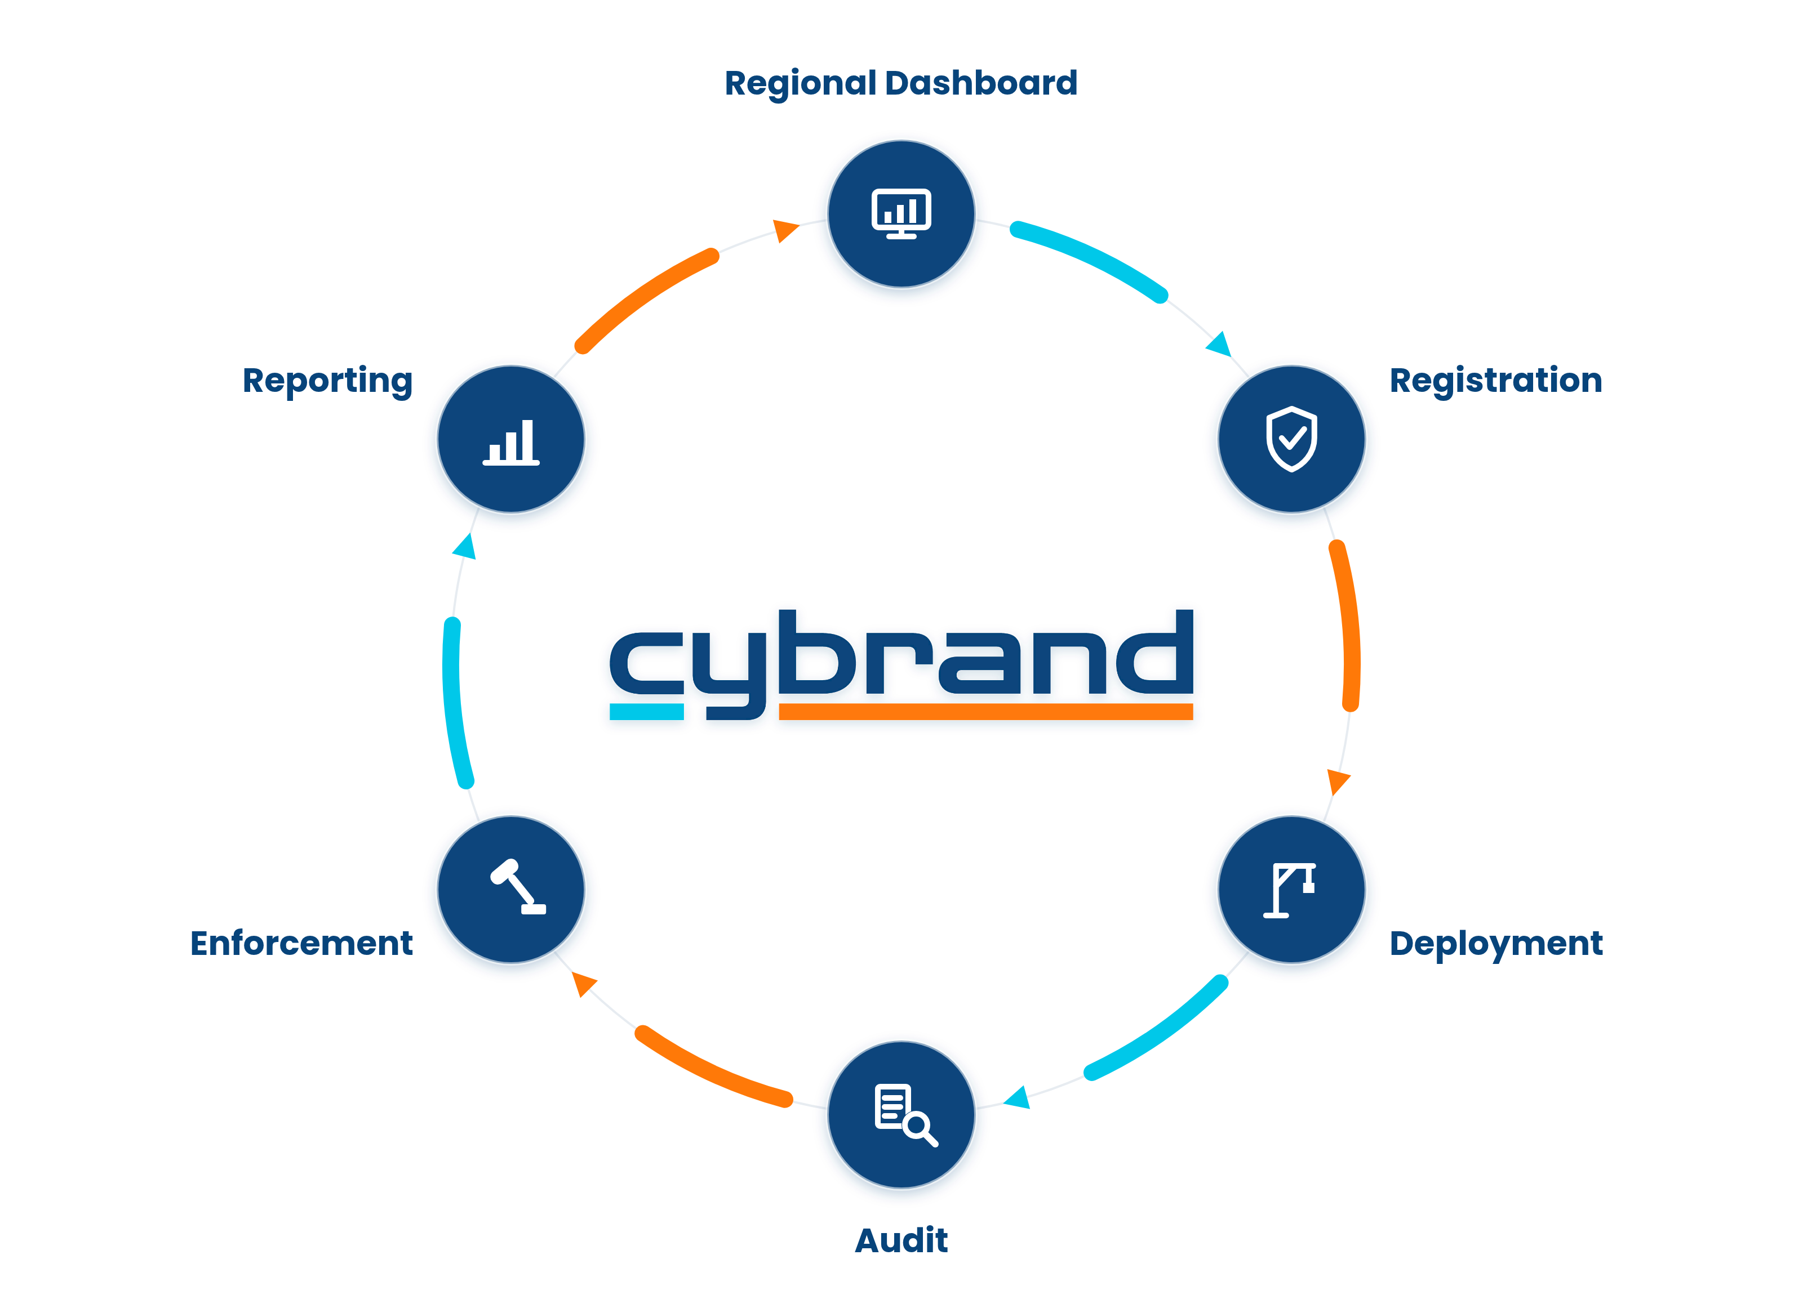
Building the Green Transition:
Who Is Measuring the North-West’s Construction Footprint?

Slide 2
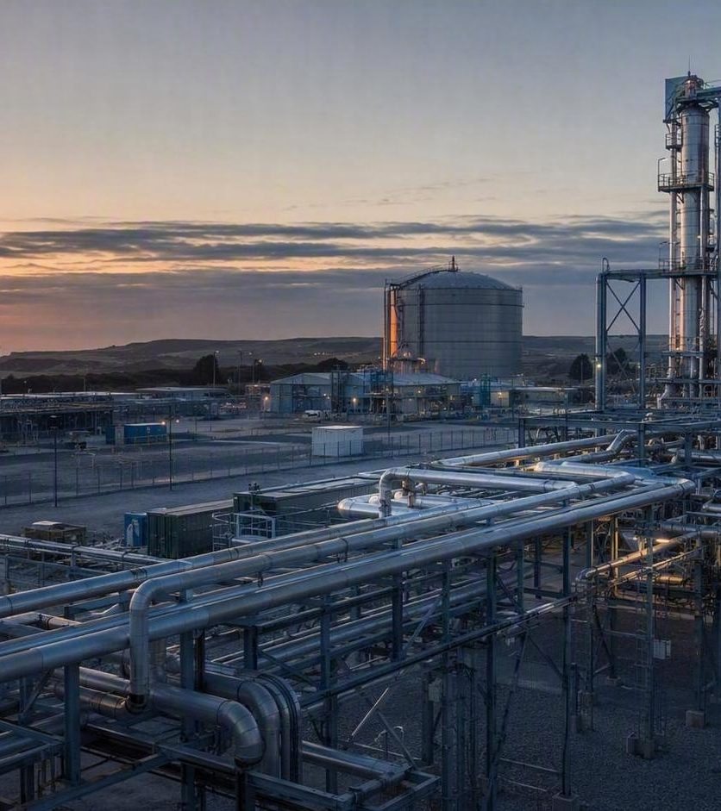
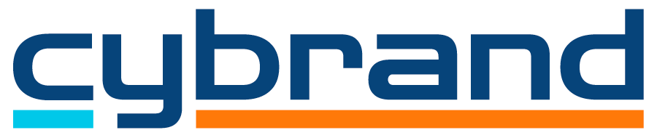

The North West is investing billions in industrial decarbonisation.
THE OPPORTUNITY
HyNet, Liverpool Bay CCS, Peak Cluster, hydrogen production, carbon capture and major industrial projects are forming a connected regional transition system.
Notes:
Source: North West Emissions Strategy — 'The Opportunity'. The region is entering one of the most significant periods of industrial transformation in its history, with major decarbonisation, hydrogen, carbon capture and advanced manufacturing programmes attracting substantial investment.

Slide 3

The transition is being presented as green by design.
THE COMMITMENT
Net zero. Industrial decarbonisation. Low-carbon energy. Climate leadership. Sustainable growth. These are not peripheral aspirations. They are central to the public case being made for investment across the region.
How will the environmental performance of the construction phase be evidenced?
Notes:
Source: North West Emissions Strategy — 'The Opportunity'. The region is entering one of the most significant periods of industrial transformation in its history, with major decarbonisation, hydrogen, carbon capture and advanced manufacturing programmes attracting substantial investment.

Slide 4
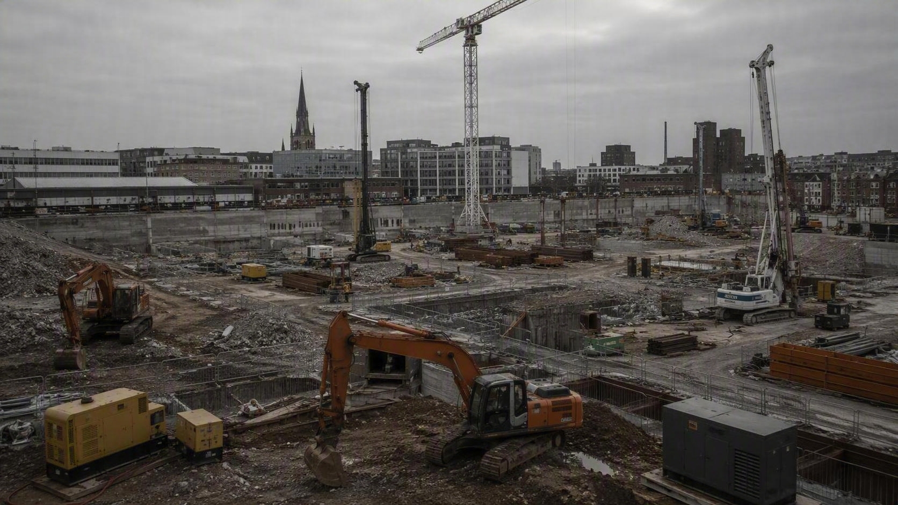
THE BLIND SPOT
Construction machinery, generators and temporary power equipment operate across major projects, but their combined regional footprint is not readily visible.
As investment accelerates, the absence of a shared baseline makes it difficult to demonstrate alignment between green commitments and construction delivery
Notes:
Source: North West Emissions Strategy — 'The Gap'. Construction machinery, generators and temporary power equipment remain one of the largest emissions sources operating on construction sites, yet local authorities have limited oversight of them.

Slide 5
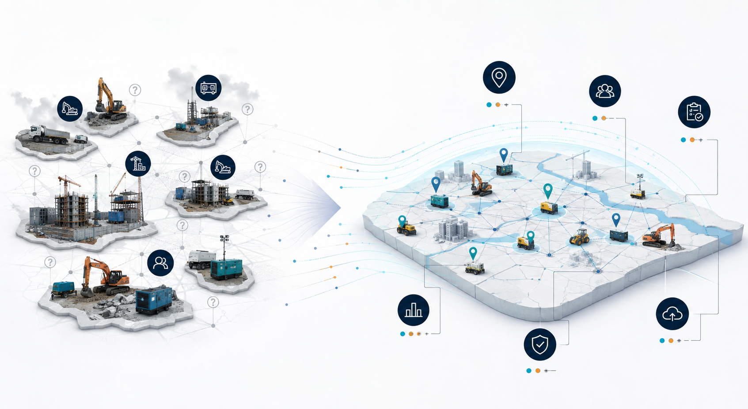
The challenge is not policy. The challenge is visibility.
THE GAP
No regional framework shows what machinery is operating, where it is operating, or whether it meets modern emissions standards.
It's not a lack of policy ambition. It's a lack of visibility, consistency and operational control.
From project-by-project reporting to a shared view of construction activity, temporary power and emissions performance.
Notes:
Source: North West Emissions Strategy — 'The Gap'. Unlike many other environmental impacts, there is no regional framework providing visibility of machinery, its location, or its emissions standard. The issue is not policy ambition but visibility, consistency and operational control.

Slide 6
This is not an untested concept.
THE PROOF
London has already demonstrated that registration, standards, auditing and industry engagement will produce measurable improvement.
London’s results provide a benchmark, not a forecast for the North-West.
10,000+
3,400+
48%
42%
20%
machines inspected
audits completed
reduction in particulates
reduction in NOx
reduction in CO₂
Achieved with minimal enforcement — one prosecution in six years of operation.
Notes:
Source: North West Emissions Strategy — 'The Proof'. London's NRMM Low Emission Zone inspected more than 10,000 machines and conducted more than 3,400 audits across over 2,800 sites, delivering 48% particulate, 42% NOx and 20% CO2 reductions — with only one prosecution in six years.

Slide 7
If London has demonstrated a practical solution, why can't the North West continue without an equivalent framework?
THE STRATEGIC QUESTION
A question of visibility and control — not process.
Notes:
Source: North West Emissions Strategy — 'The Strategic Question'. The question is not how planning applications would be processed; it is whether local authorities want greater visibility and control over construction-related emissions while billions of pounds of industrial investment flow into the region.

Slide 8
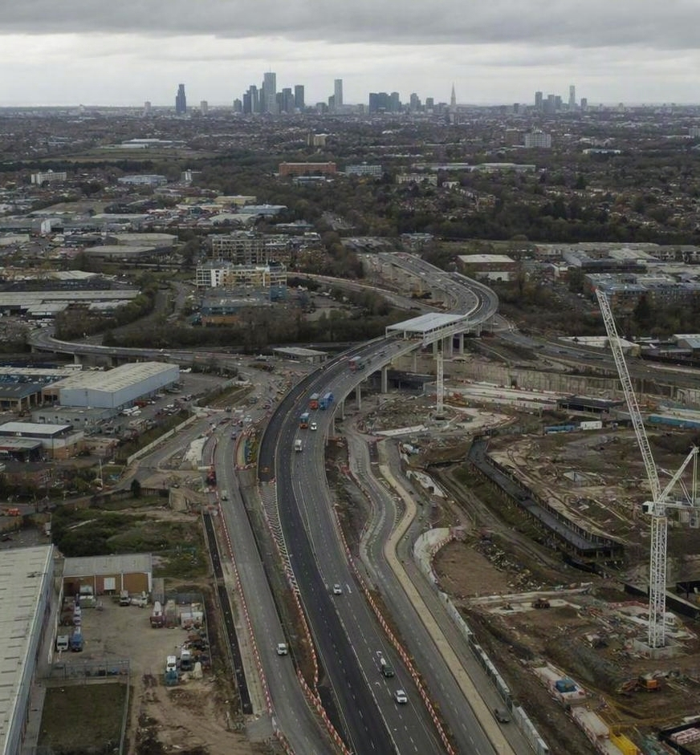
Industrial transformation is accelerating.
WHY NOW
Up to £17bn
economic opportunity
6,000
direct regional jobs
Up to 10m tonnes
annual CO₂ captured by early 2030s
4m tonnes
annual emissions in Cheshire West & Chester
53%
of local emissions linked to industry
Notes:
Figures provided in the brief alongside the North West Emissions Strategy: industrial operations account for 53% of local emissions and around 4 million tonnes of greenhouse gas emissions annually across Cheshire West & Chester, which sits at the centre of this investment activity.

Slide 9
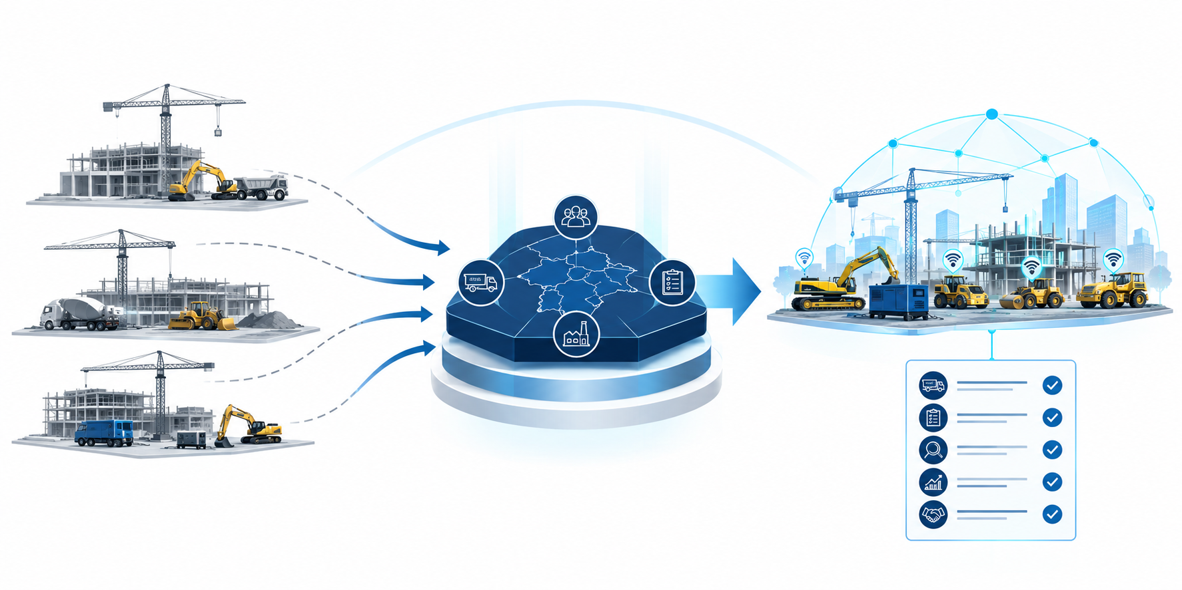
Visibility. Standards. Accountability.
THE PROPOSAL
What a North West NRMM framework could deliver.
Machinery visibility
Cleaner construction
Consistent standards
Climate alignment
Emissions reporting
Independent inspections
Notes:
Source: North West Emissions Strategy — 'The Proposal'. A North West NRMM scheme would provide machinery visibility, consistent emissions standards, independent inspection and verification, data-driven reporting, support for cleaner construction, and alignment with local air-quality and climate commitments.

Slide 10
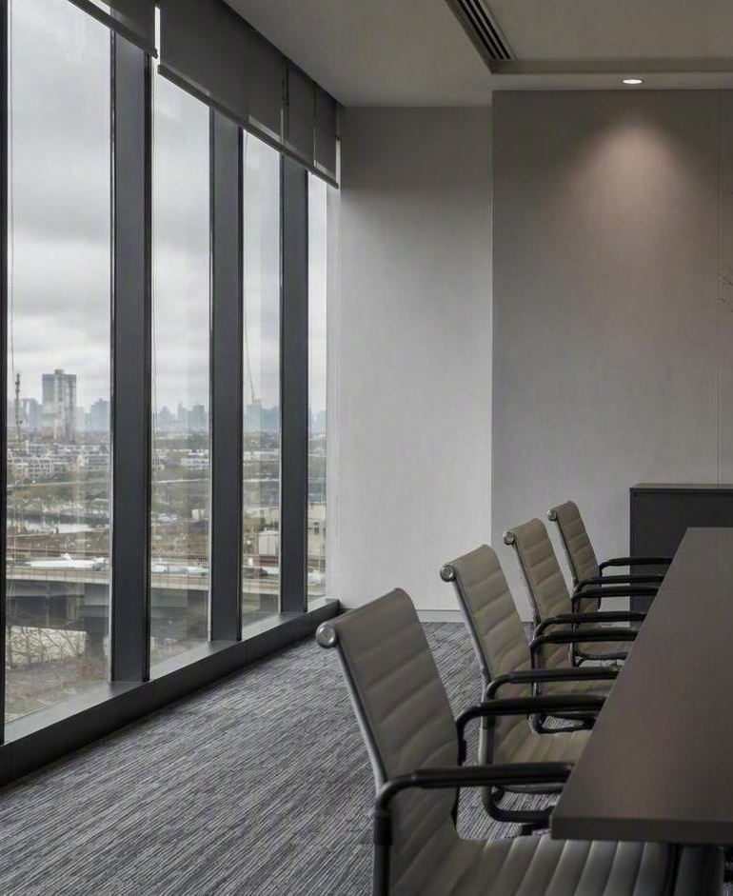
London has already demonstrated what is possible.
THE DECISION
Construction emissions can be reduced significantly through visibility, standards and industry engagement.
Should the North West lead, follow or do nothing?
Notes:
Source: North West Emissions Strategy — closing statement. London proved construction emissions can be reduced by nearly half through visibility, standards and industry engagement. The opportunity now is to determine whether the North West wants to lead, follow, or do nothing.

Slide 11
Help define the construction footprint
Cybrand is opening a discussion with project developers, industrial operators, construction partners, local authorities and regional stakeholders about how construction emissions and temporary power can be better understood across the North West industrial transition.
If your organisation is delivering, commissioning or governing major projects in the region, join the conversation.

